Slide 1
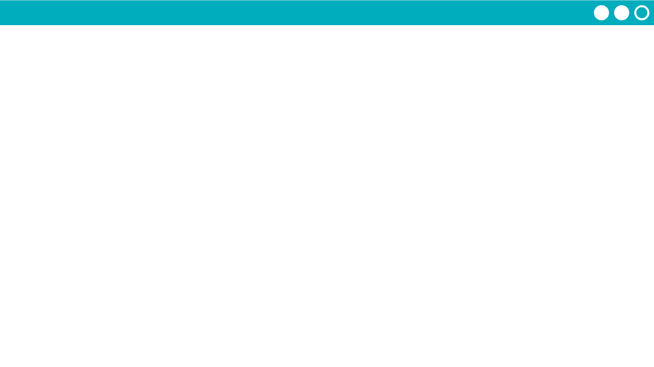
Unit 2 Lesson 3 - Activity
Do This: With your group follow the same directions to set up Week 2
If you are a group of 5, everyone cross out Sunday
If you are a group of 4, everyone cross out Sunday and Saturday
Cross out a new random day
Week 2
Day | Classmate Name
Monday
Tuesday
Wednesday
Thursday | XXXX BUSY XXXX
Friday
Saturday | XXXXXXXXXXX
Sunday | XXXXXXXXXXX

