Slide 1


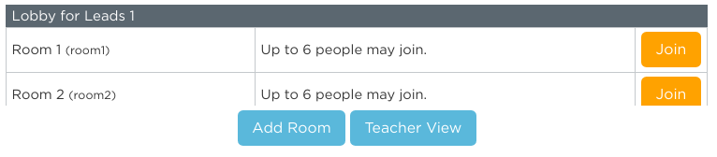
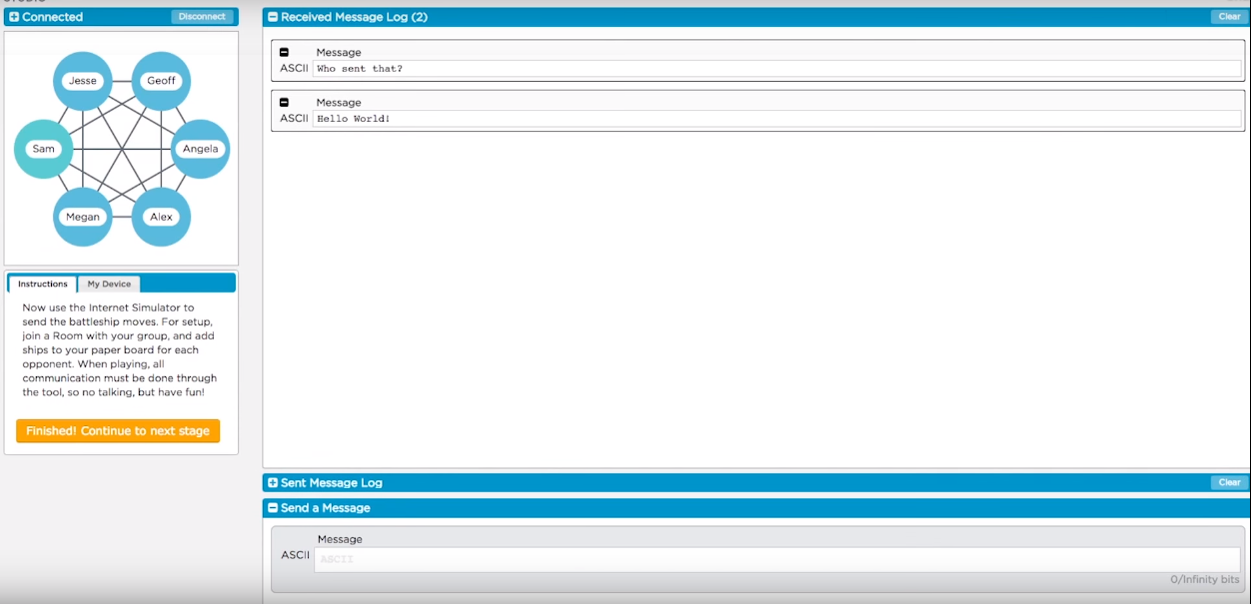
Unit 2 Lesson 3 - Activity
Complete Week 2!
Do This:
Go to Lesson 3 - Level 1
Join a room with your group mates.
Once everyone is in the room complete Week 2 on the simulator.
No talking!

