Slide 1



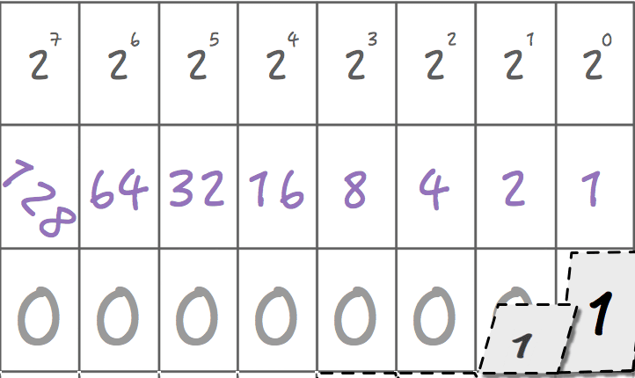
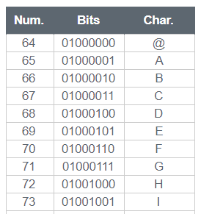

Unit 2 Lesson 1 - Warm Up
Prompt:
We’ve learned to represent images, text, and sound digitally - but we haven’t discussed what we do with all this digital data. How do you see people sharing this kind of data in the real world? Who do they want to share it with and why?

