Slide 1

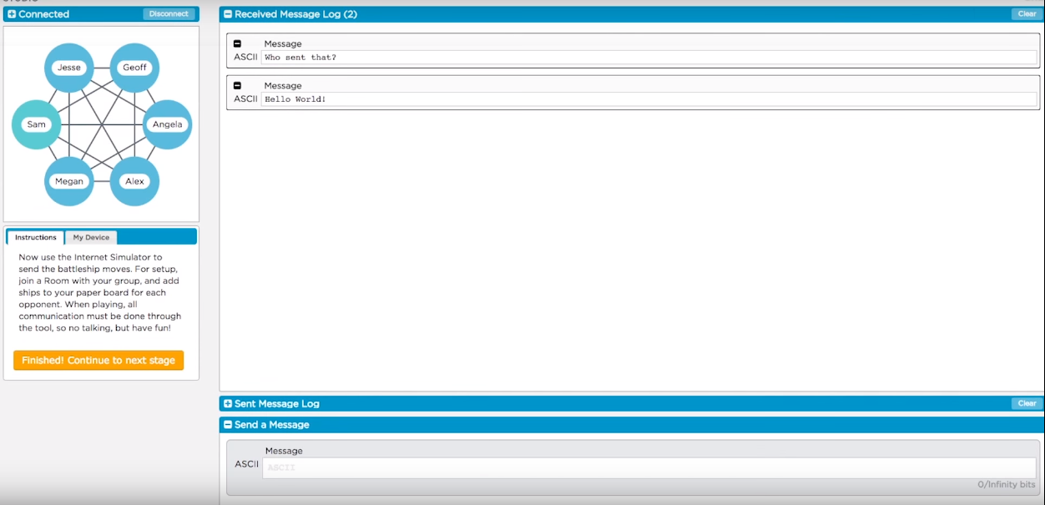
Unit 2 Lesson 3 - Activity
Complete Week 3!
Do This:
Agree with your group on the set of rules you'd like to try this time around for how to communicate.
Set up your boards for Week 3
Complete Week 3, again no talking!

