Slide 1

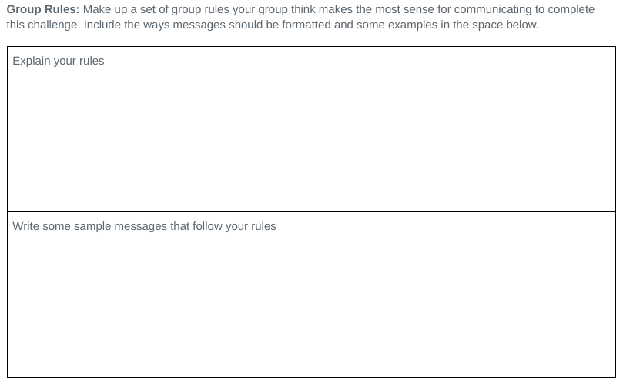
Unit 2 Lesson 3 - Activity
Do This: Based on your experience, take 5 minutes to write down in the rules section the collective rules you and your team would advise using going forward.
Be ready to share!

