Slide 1



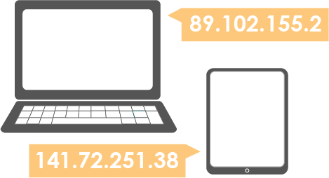
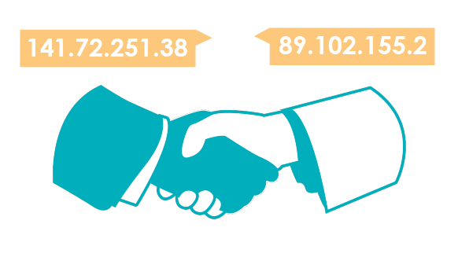
Unit 2 Lesson 3 - Wrap Up
Protocol: An agreed-upon set of rules that specify the behavior of some system
IP Address: The unique number assigned to each device on the Internet.
Internet Protocol (IP): a protocol for sending data across the Internet that assigns unique numbers (IP addresses) to each connected device

