Slide 1

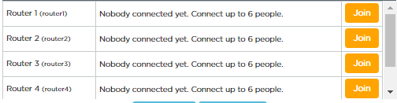
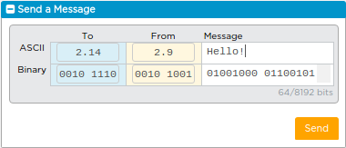
Unit 2 Lesson 4 - Activity
Updated Internet Simulator
Step 1: Open the Internet Simulator
Connect to the same router number as your group
Step 2: Say Hello!
Use the updated version of the Internet Simulator to send a message saying hello to everyone in your group.
Everyone now has an IP Address! This will be important in today’s simulation.

