Slide 1
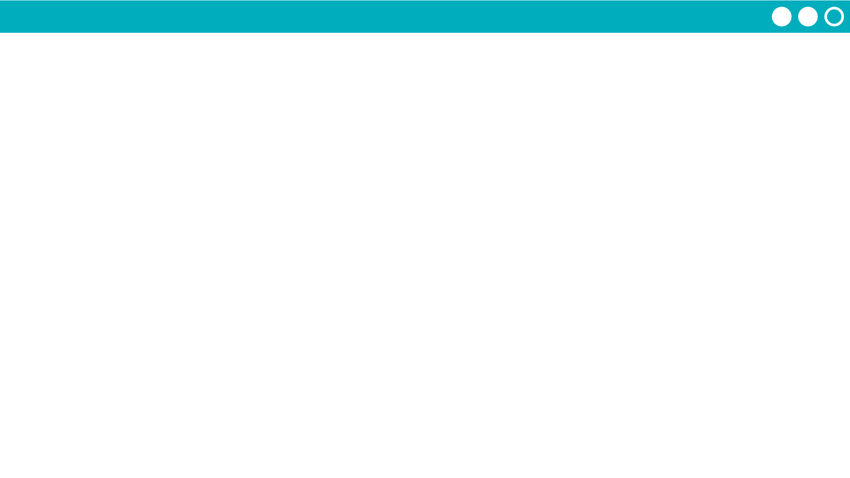
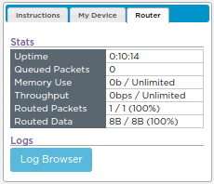
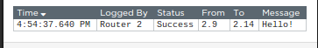
Unit 2 Lesson 4 - Activity
Open the Router Logs
Step 1: Open the Log Browser
Step 2: Look at the Messages

