Slide 1
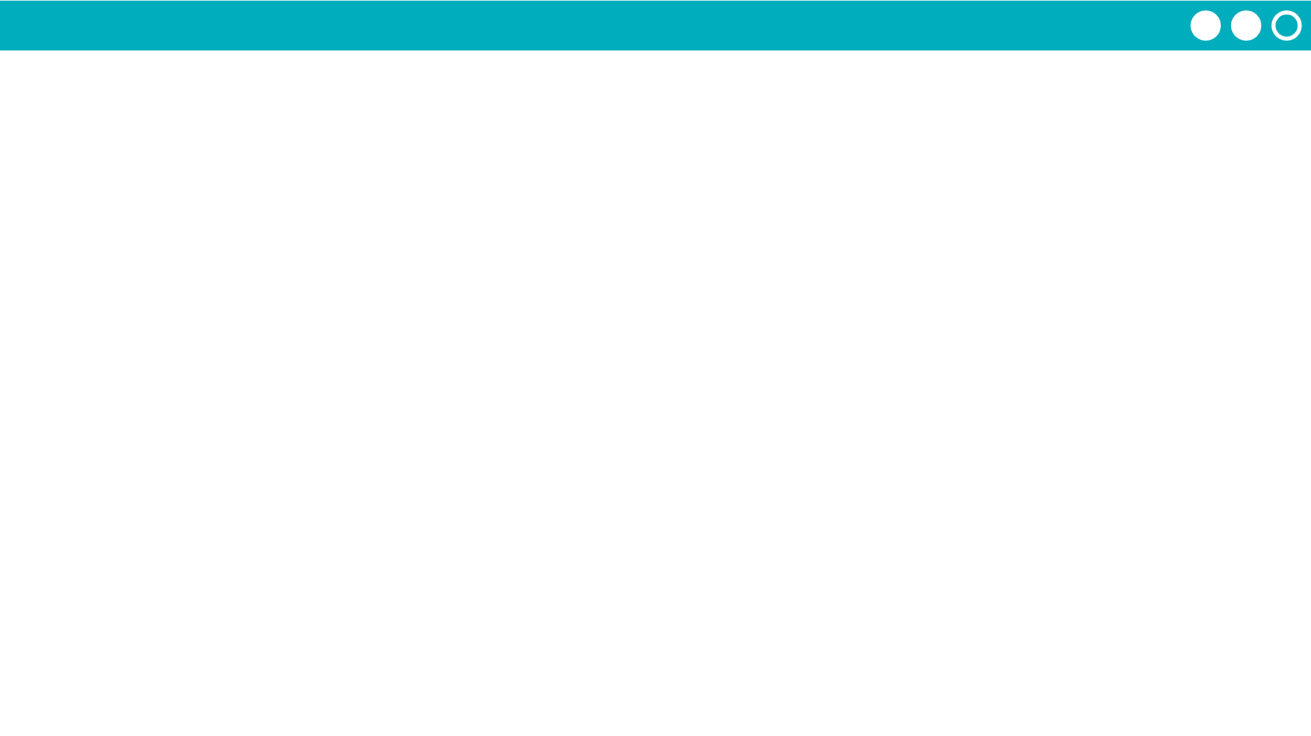
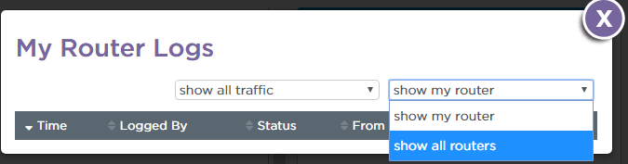
Unit 2 Lesson 4 - Activity
Open the Router Logs
Step 3: View All Messages (including other routers)

