Slide 1
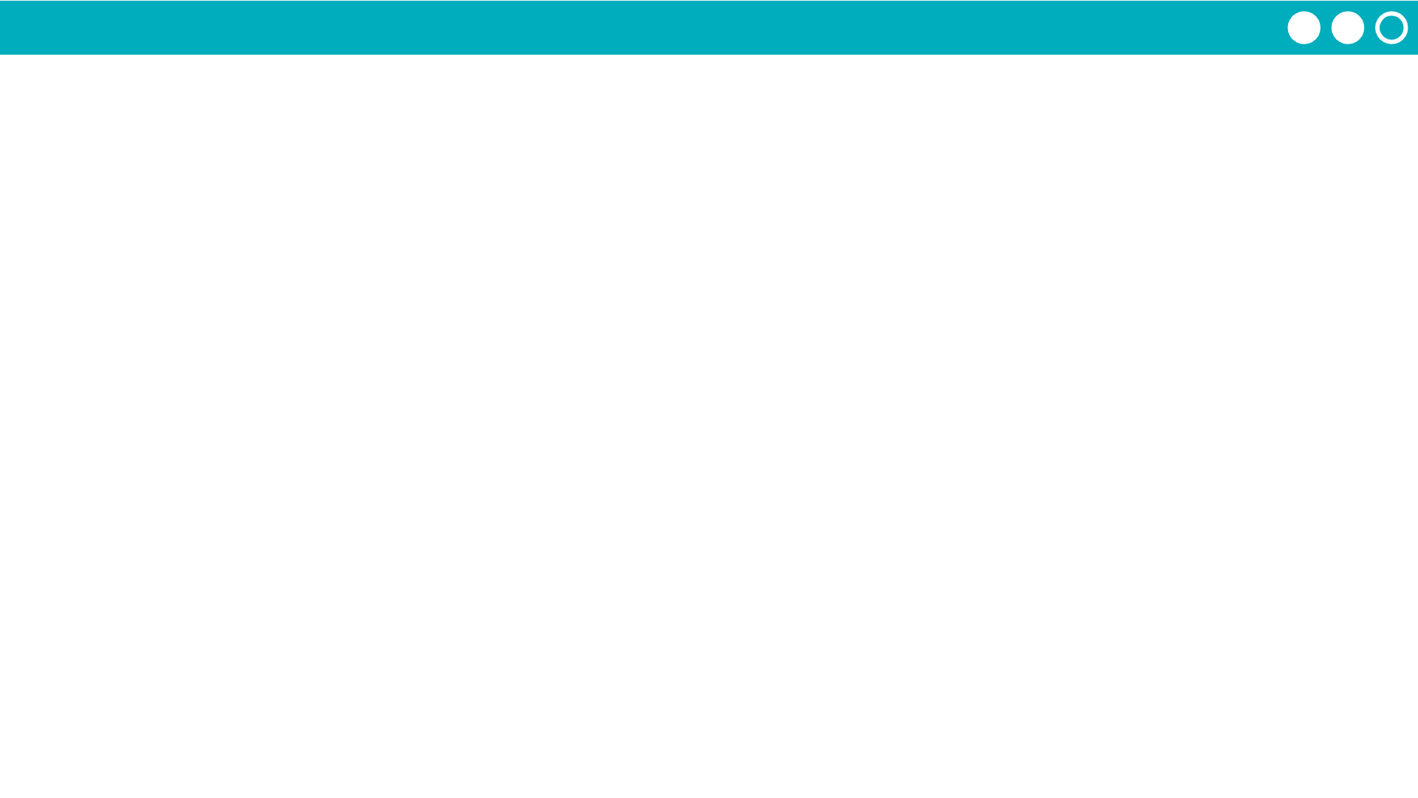
Unit 2 Lesson 4 - Activity
Silly Class Survey
Use the Router Logs to choose an IP address from each of the other routers.
Send each person a message asking who they are and choose one of the following questions:
What is your favorite food?
What is your favorite type of animal?
What is your favorite color?
Be sure to also respond to questions you get from people on other routers!

