Slide 1
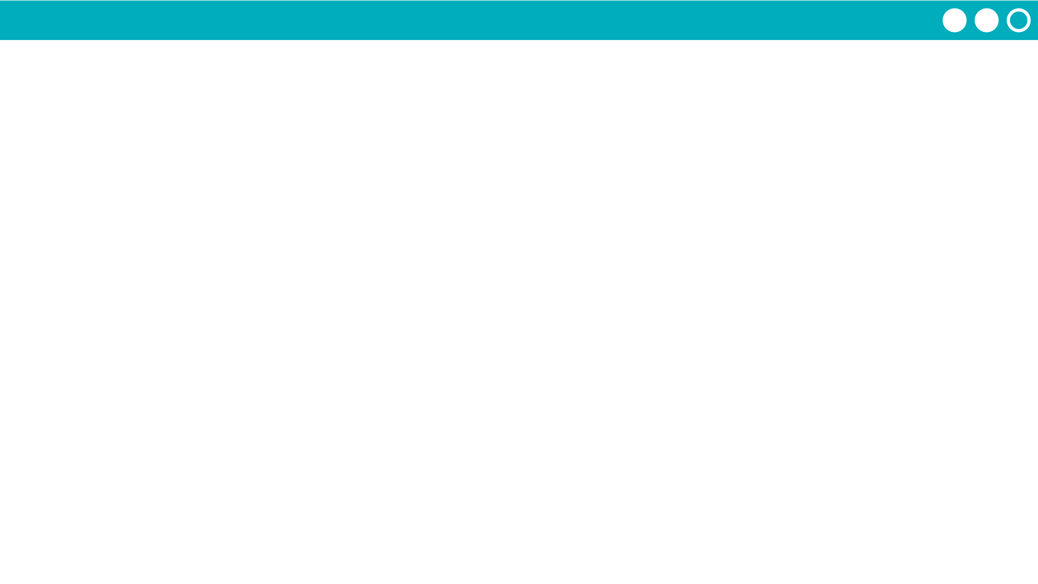
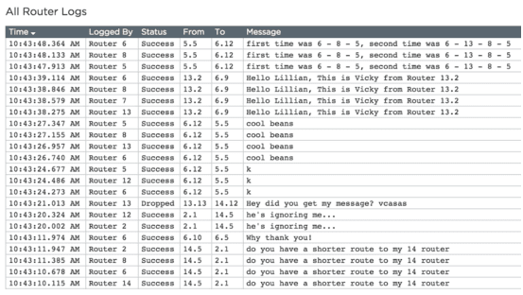
Unit 2 Lesson 4 - Activity
Open the Router Logs
Open the Router Logs Again. You should see a lot more messages now

