Slide 1
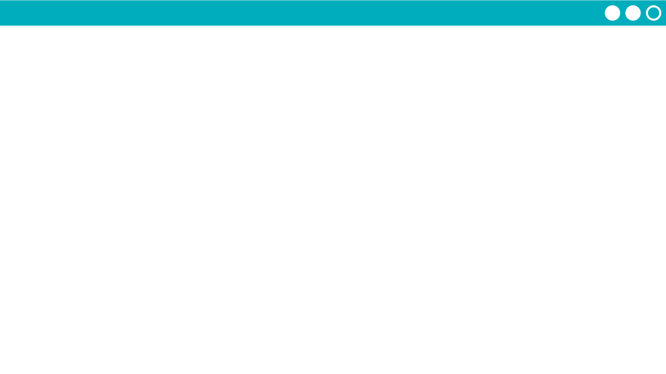
Unit 2 Lesson 4 - Activity
Prompt:
Can you predict why some messages are appearing multiple times?

