Slide 1
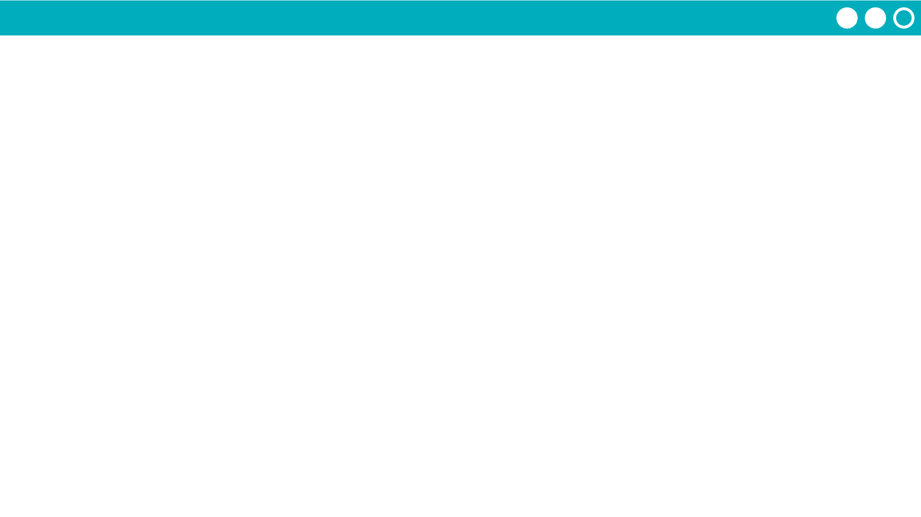
Unit 2 Lesson 4 - Activity
Do This:
Pick someone on a different router and send three separate messages with your top three favorite movies or TV shows.
After you send the messages, open the router logs and find these same messages in the logs. Notice how these messages traveled through the network. Did they always take the same path from your router to the other router?
Look at other messages that are being sent. Are there any patterns in the paths that they take?

