Slide 1
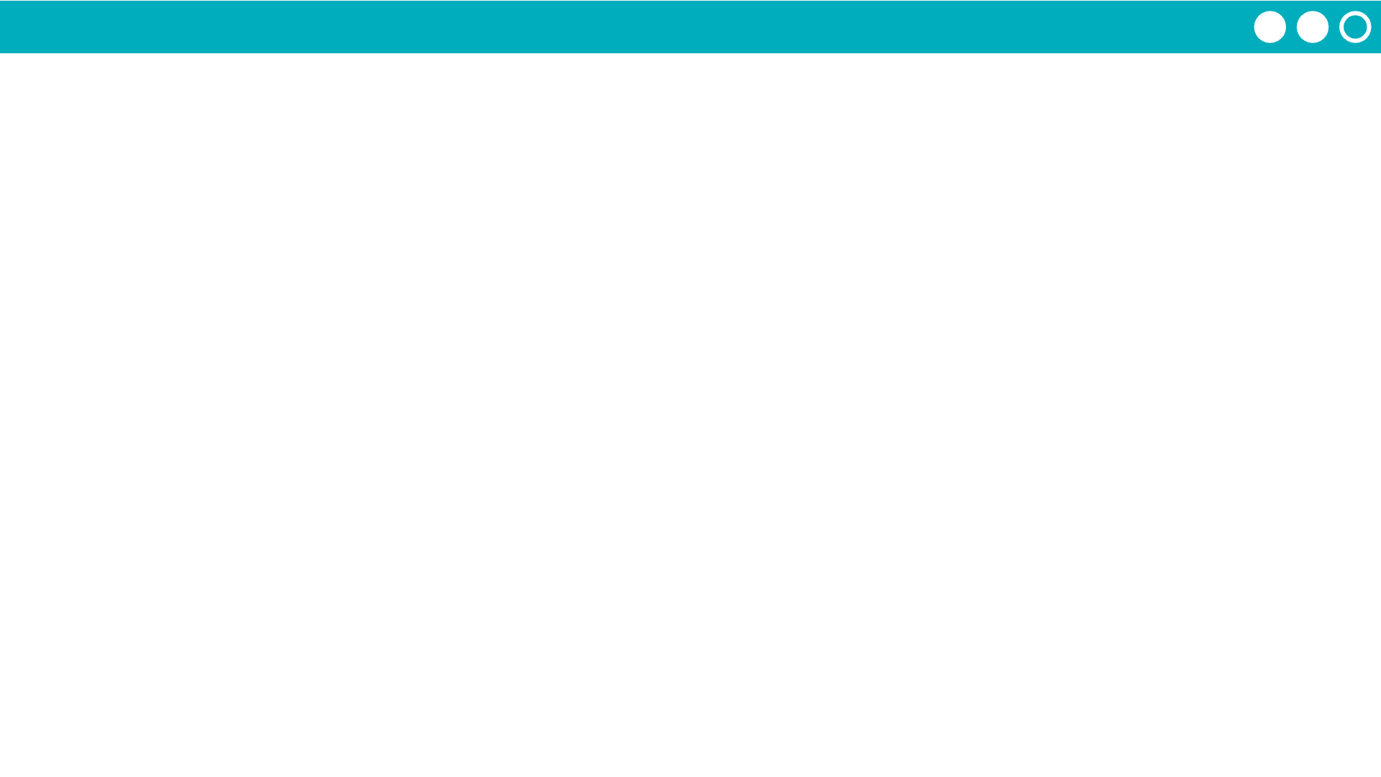
Unit 2 Lesson 4 - Activity
Prompt: What did you notice about the messages you sent in the router logs?
Did they always take the same path from your router to the other router?

