Slide 1

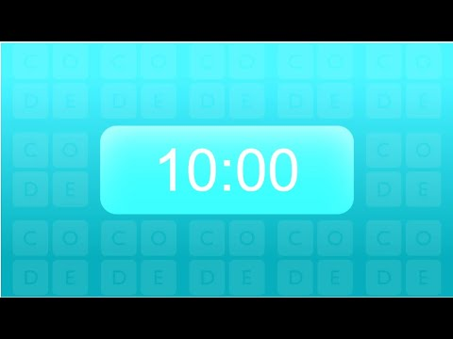

Unit 2 Lesson 1 - Activity
Prompt: Answer each of these questions your journal.
What is the Internet?
What questions do you have about how the Internet works?
AP CSP
Journal

