Slide 1
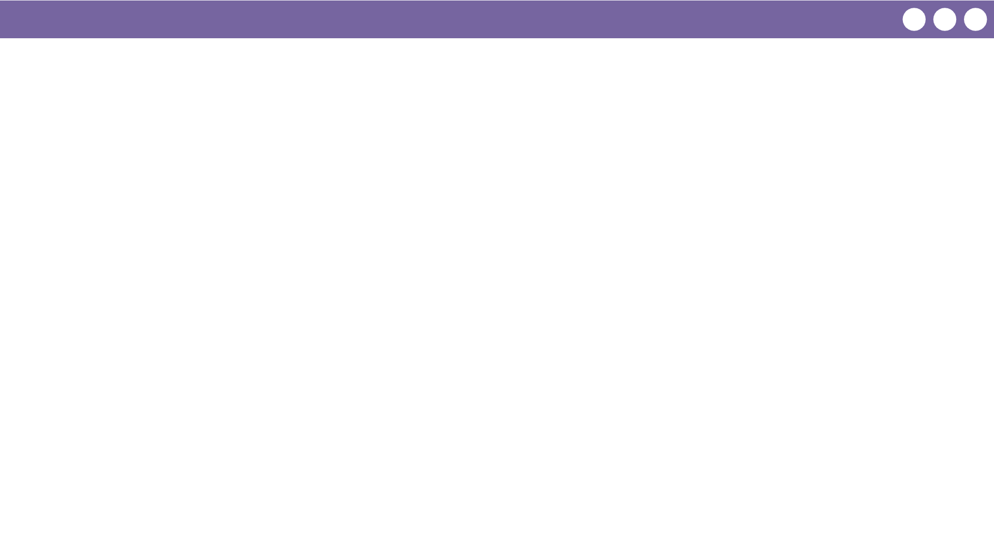
Unit 2 Lesson 4 - Wrap Up
Prompt:
Thinking about these terms (router, redundancy, and fault tolerant), how can we describe what we’ve observed in the router logs at the end of this activity?
What are some practical reasons that you think messages might take different paths from one router to the other?

