Slide 1

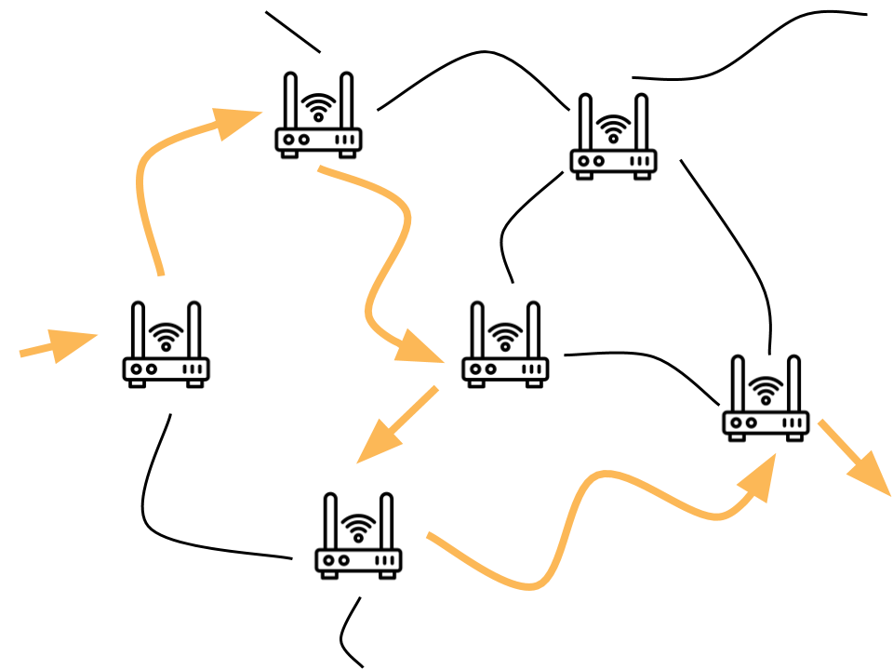

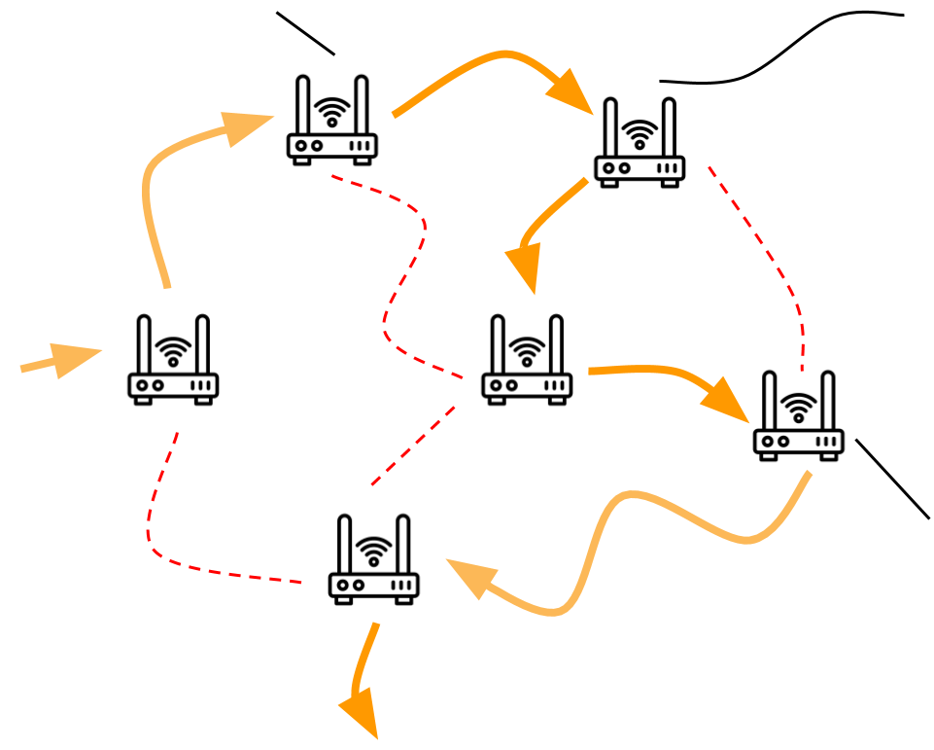
Unit 2 Lesson 4 - Wrap Up
Router: A type of computer that forwards data across a network
Redundancy: the inclusion of extra components so that a system can continue to work even if individual components fail, for example by having more than one path between any two connected devices in a network.
Fault Tolerant: Can continue to function even in the event of individual component failures. This is important because elements of complex systems like a computer network fail at unexpected times, often in groups.

