Slide 1

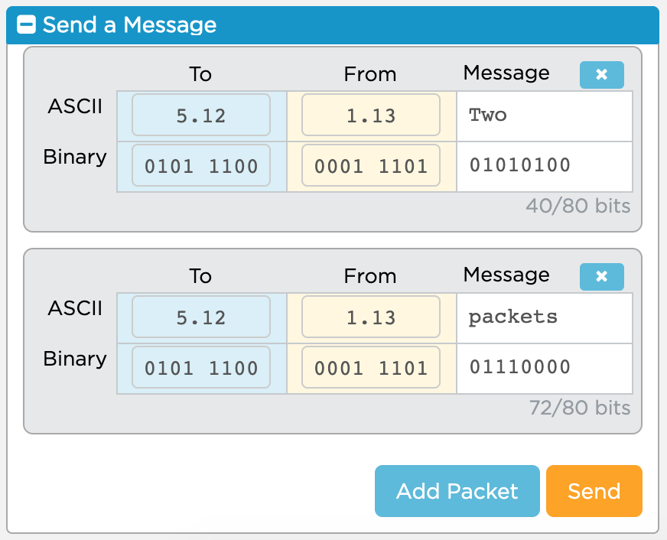
Unit 2 Lesson 5 - Activity
What changed?
A single message can be made up of many “packets” which you can add with the “Add Packet” button
Packets can only be 80 bits long
16 bits are already used for packet metadata, data added to help route the messages
You only have 64 bits, or 8 ASCII characters free for each of your messages

