Slide 1

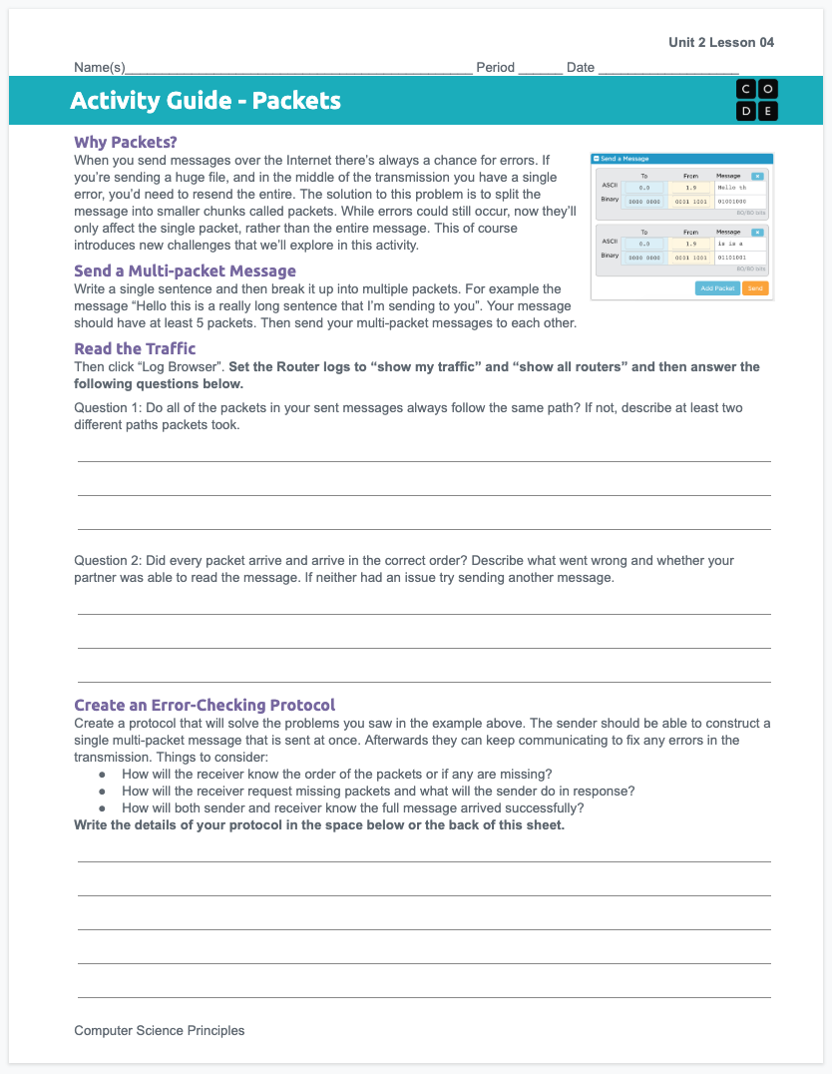

Unit 2 Lesson 5 - Activity
Packets
You should have:
Activity Guide

