Slide 1

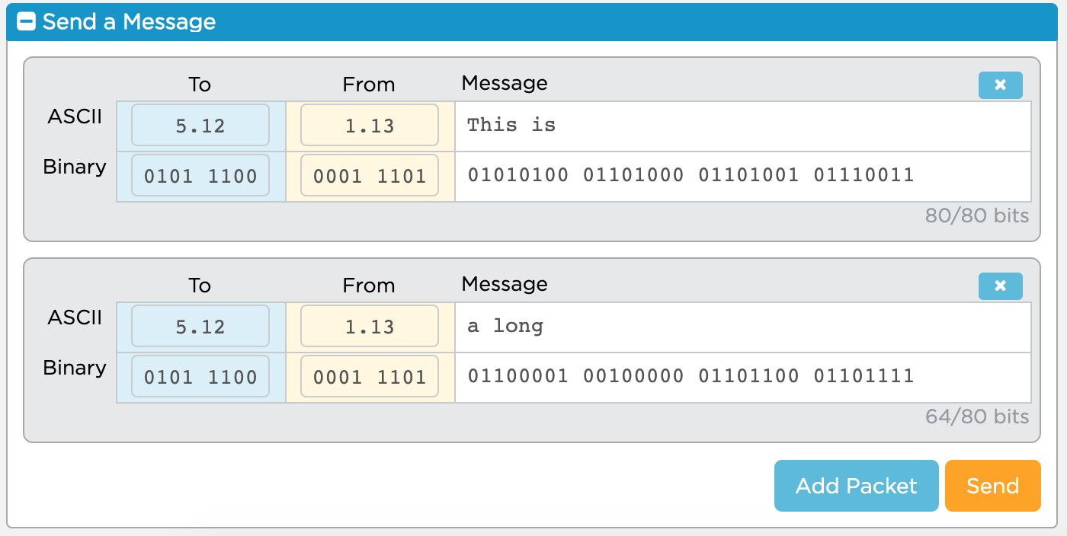
Unit 2 Lesson 5 - Activity
Protocol 1 - Just Send the Packets
Send a single message that includes 5 - 10 packets to your partner.

