Slide 1
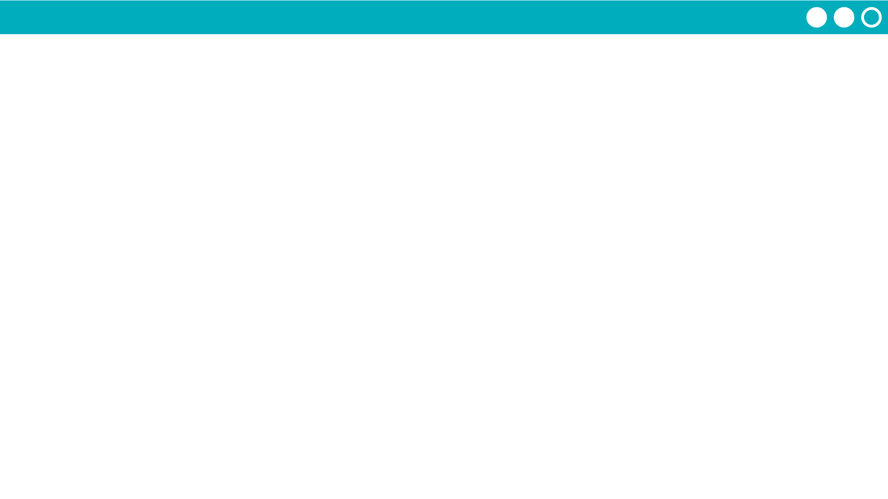
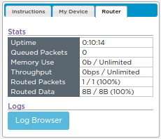
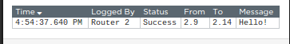
Unit 2 Lesson 5 - Activity
Read the Traffic
Step 1: Open the Log Browser
Step 2: Filter to your traffic on all routers
Step 3: Read the traffic and answer the questions in your activity guide.

