Slide 1

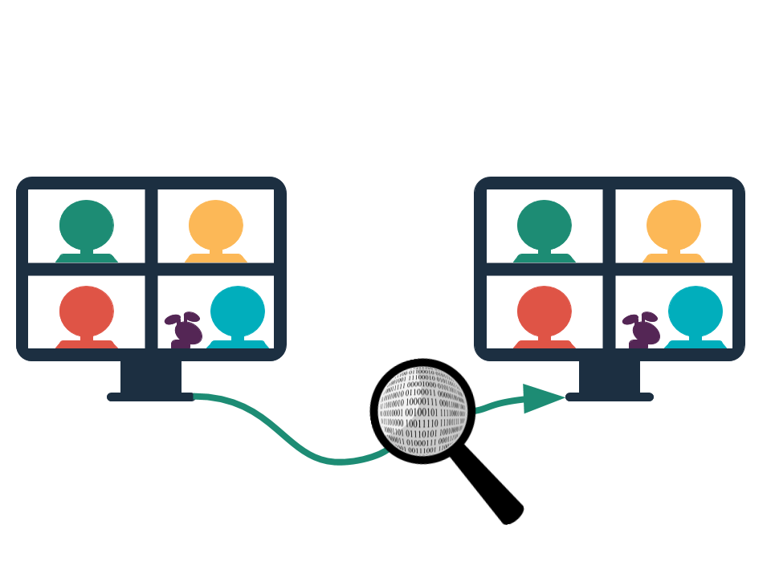
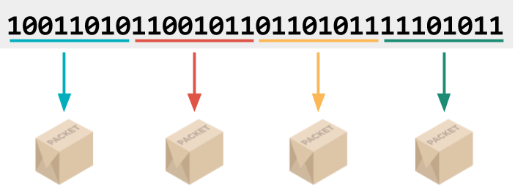
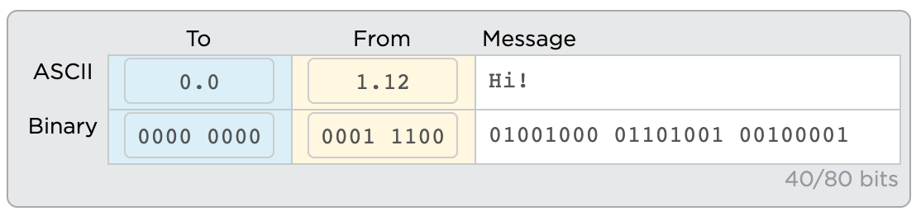
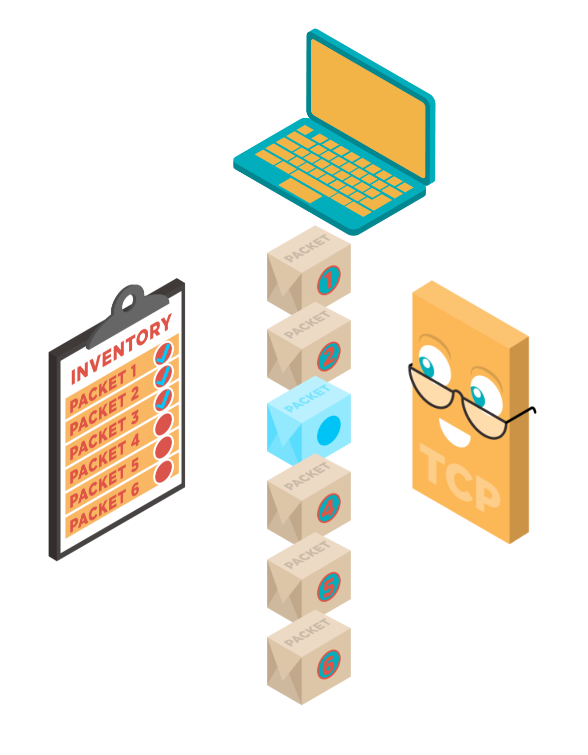


Unit 2 Lesson 5 - Wrap Up
Datastream: Information passed through the internet in packets.
Packet: A chunk of data sent over a network. Larger messages are divided into packets that may arrive at the destination in order, out-of-order, or not at all.
Packet Metadata: Data added to packets to help route them through the network and reassemble the original message.
The IP address of the sender and receiver helps route the message.
Transmission Control Protocol (TCP): A protocol for sending packets that does error-checking to ensure all packets are received and properly ordered
User Datagram Protocol (UDP): A protocol for sending packets quickly with minimal error-checking and no resending of dropped packets
X
X

