Slide 1

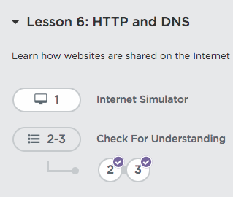
Unit 2 Lesson 6 - Activity
Let’s go use the final version of the Internet Simulator
This time we won’t cheat and ask out loud for one another’s IP addresses!
Do This:
Go to Level 1
on Code Studio

