Slide 1

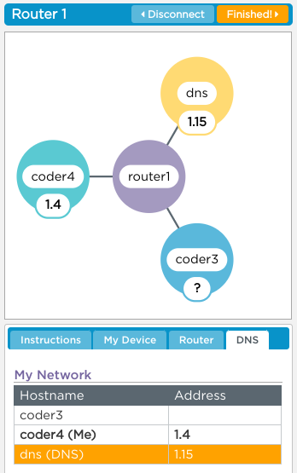
Unit 2 Lesson 6 - Activity
Do This:
Log into this version of the Internet Simulator
No talking at all, not even to get your partner’s IP address
Ask the DNS for the IP address of a user by sending GET username
Use the IP address you get back to communicate with at least 2 friends. You can talk about
In your ideal world what time would school start?
What would you eat for your perfect meal?

