Slide 1


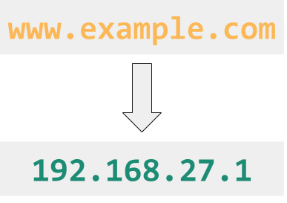
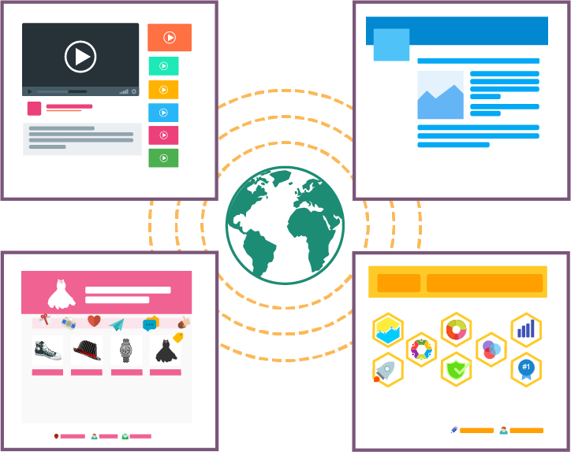

Unit 2 Lesson 6 - Wrap Up
Key Takeaways:
Scalability: the capacity for the system to change in size and scale to meet new demands
The Domain Name System (DNS): the system responsible for translating domain names like example.com into IP addresses
Hypertext Transfer Protocol (HTTP): a protocol for computers to request and share the pages that make up the world wide web on the Internet
World Wide Web: a system of linked pages, programs, and files
The World Wide Web is different from the Internet. The World Wide Web are files, web pages and media. The Internet is the network we use to access those files.
The DNS is an important system in helping the Internet scale.

