Slide 1

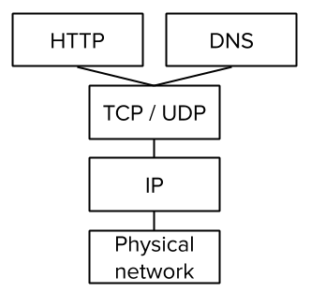

Unit 2 Lesson 6 - Wrap Up
Prompt:
Using your Layers of the Internet activity guide to help you, explain how each of the different layers is involved when you go to a link like code.org?
code.org

