Slide 1
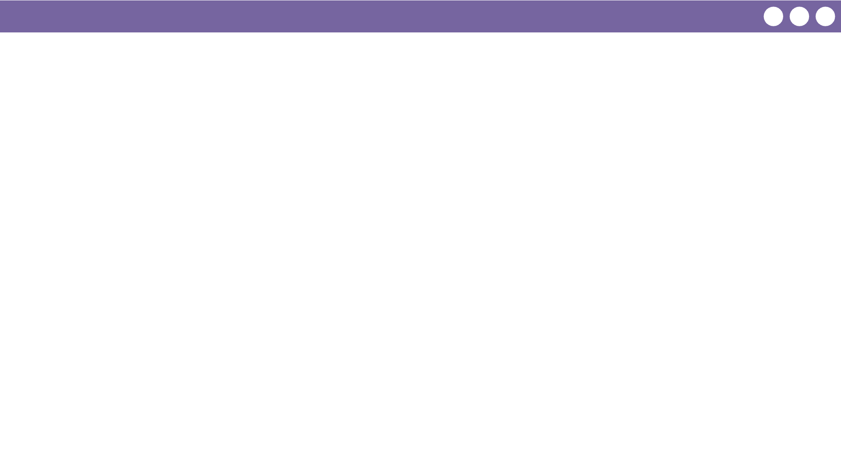
Unit 3 Lesson 1 - Wrap Up
Prompt:
Think of your favorite app. Discuss with a partner what the user interface looks like and the inputs and outputs.

