Slide 1

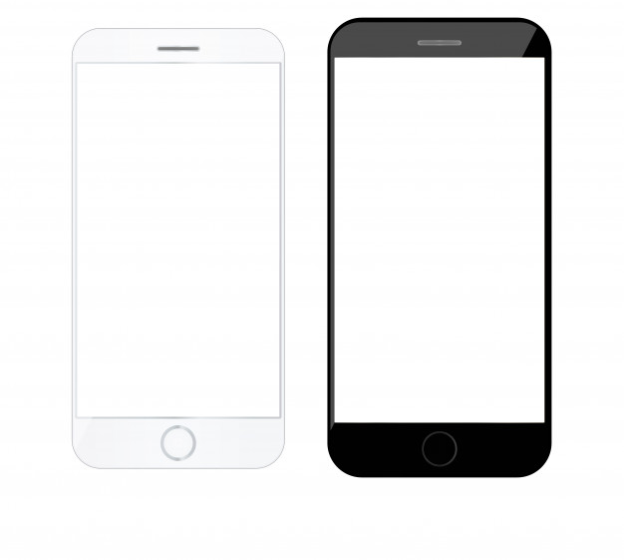
Unit 3 Lesson 2 - Warm Up
Prompt:
What is a common app that you use? Take a minute to sketch the User Interface of the main screen. Note how the user interacts with the app.

