Slide 1

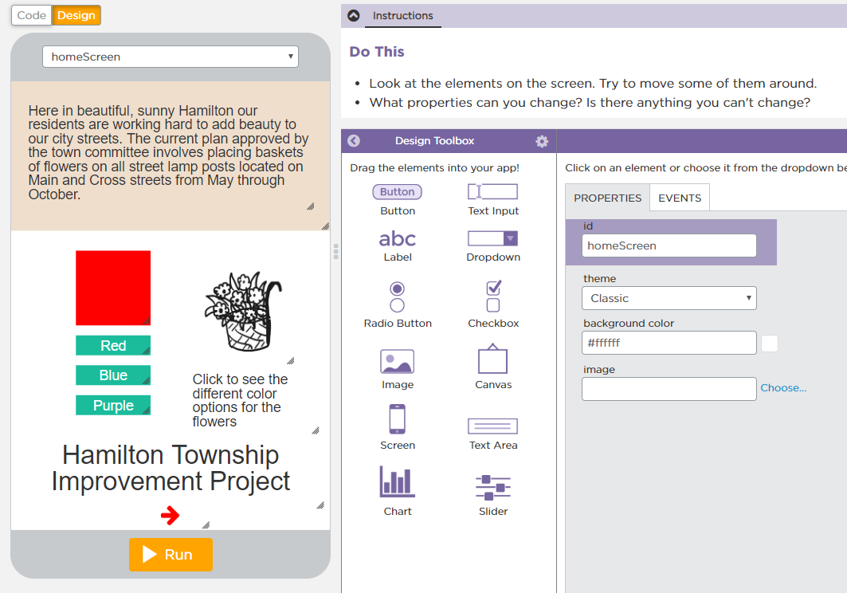

Unit 3 Lesson 2 - Activity
Introduction to Design Mode

