Slide 1

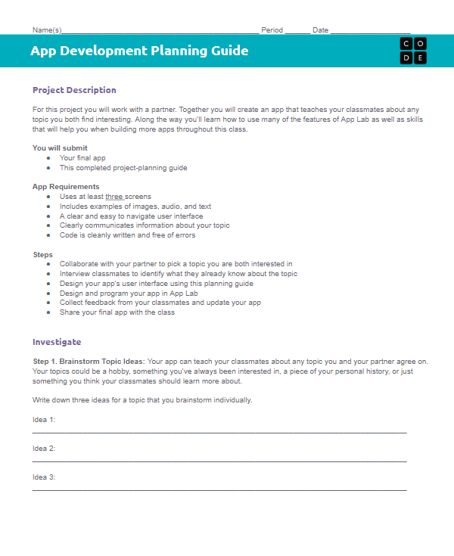

Unit 3 Lesson 3 - Activity
Designing an App Part 1
You should have:
App Development Planning Guide

