Slide 1

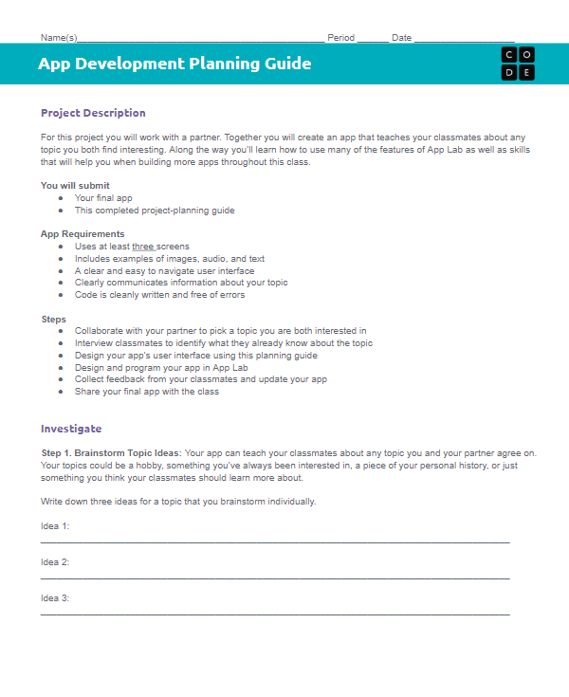
Unit 3 Lesson 3 - Activity
Step 1:
Brainstorm Topic Ideas

