Slide 1

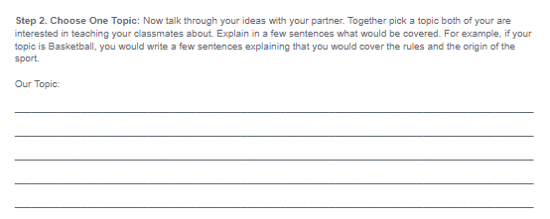
Unit 3 Lesson 3 - Activity
Step 2:
Choose One Topic

