Slide 1

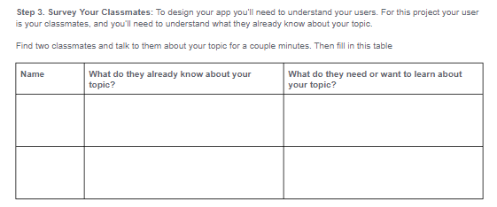
Unit 3 Lesson 3 - Activity
Step 3:
Survey Your Classmates

