Slide 1

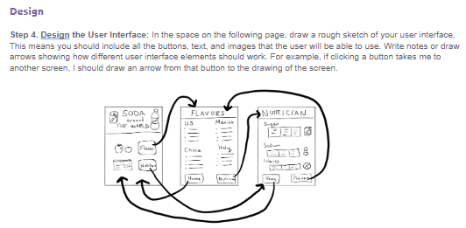
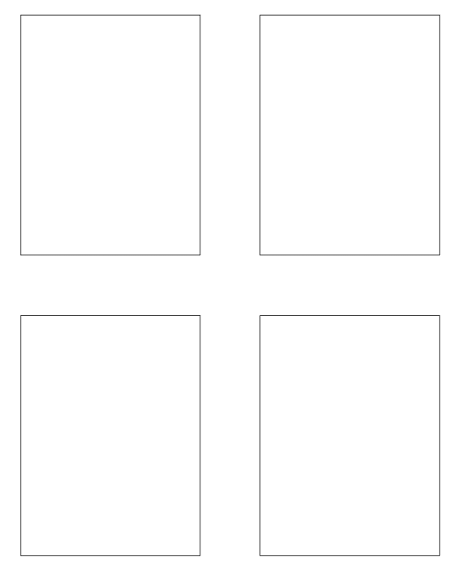
Unit 3 Lesson 3 - Activity
Step 4:
Design the User Interface

