Slide 1

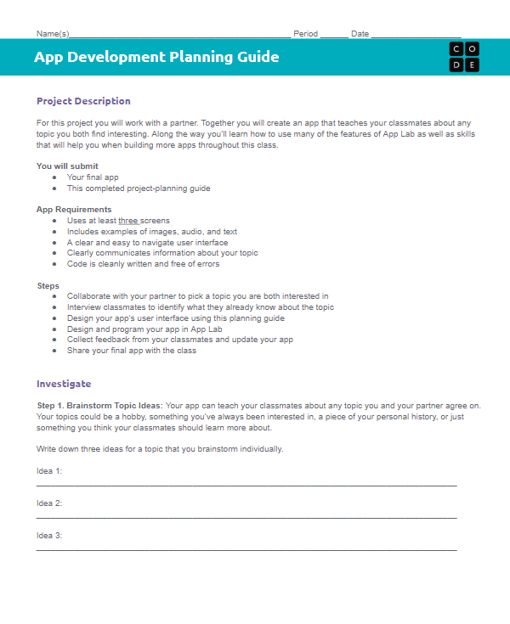

Unit 3 Lesson 4 - Activity
Designing an App Part 2
You and your partner should have:
App Development Planning Guide
Pen/Pencil

