Slide 1
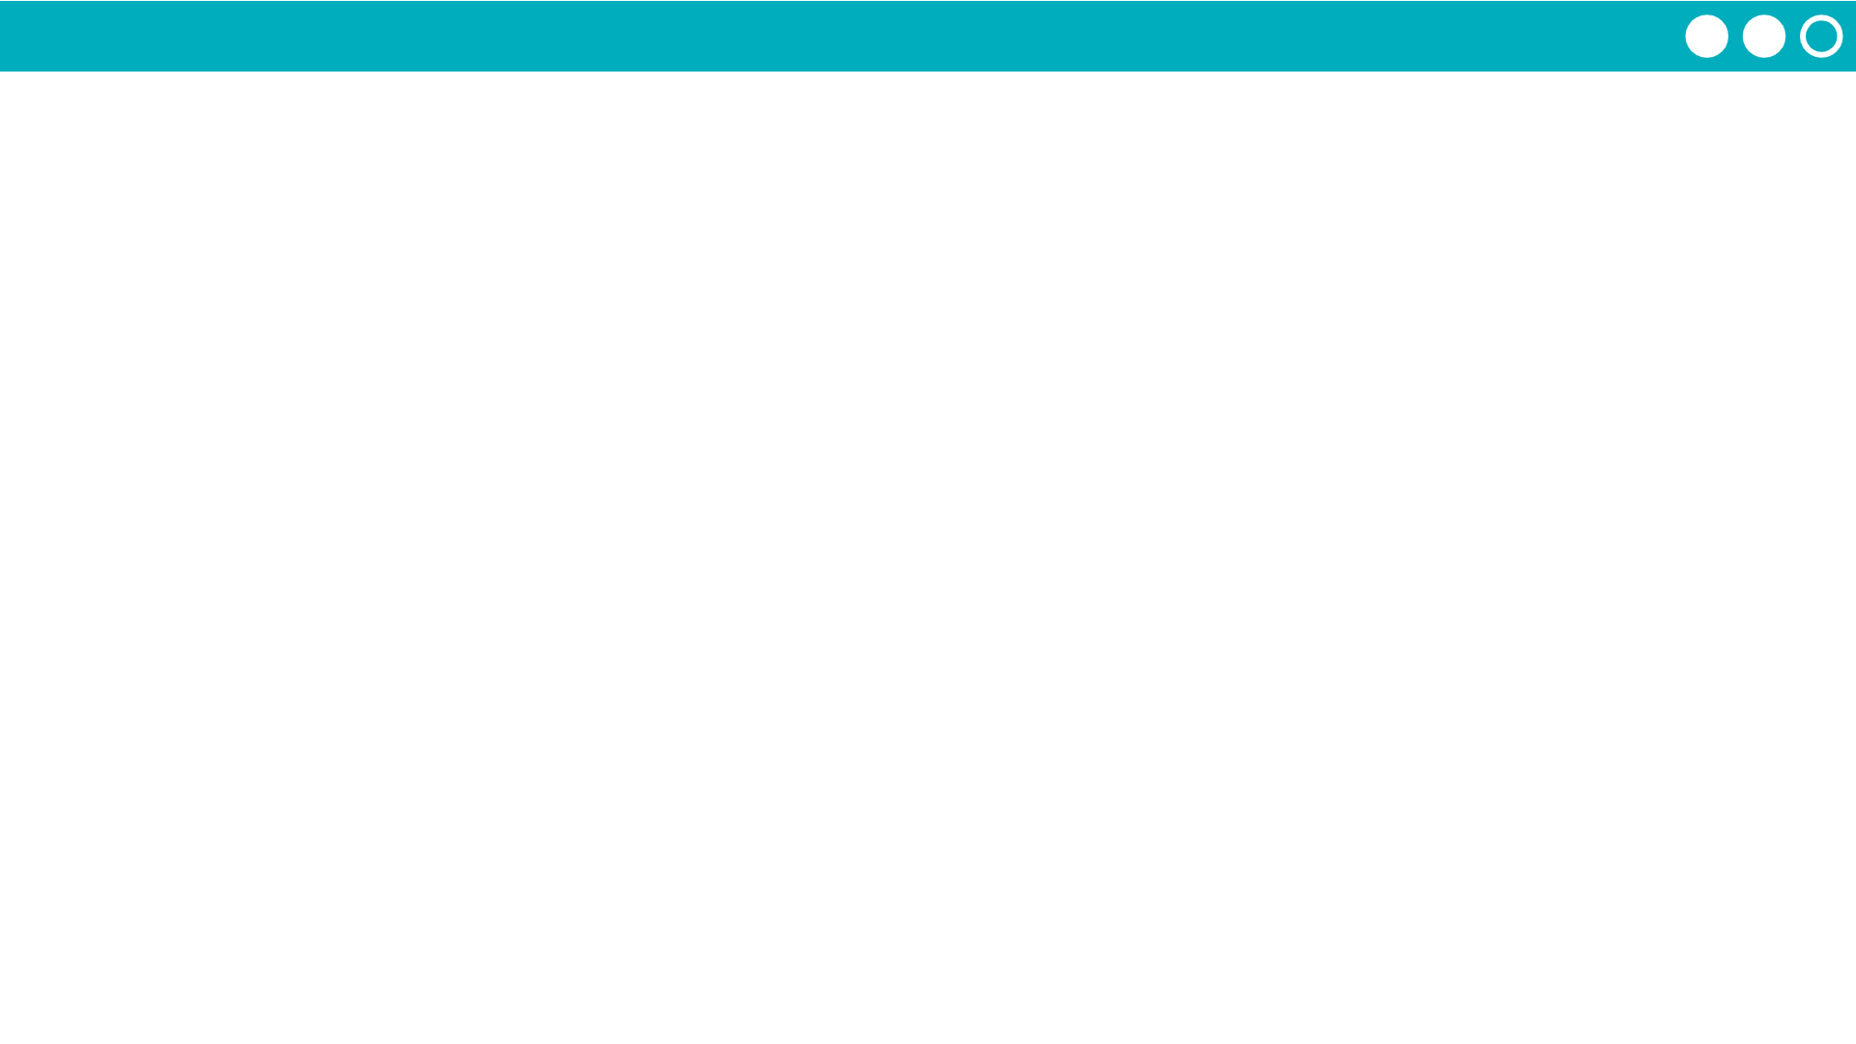
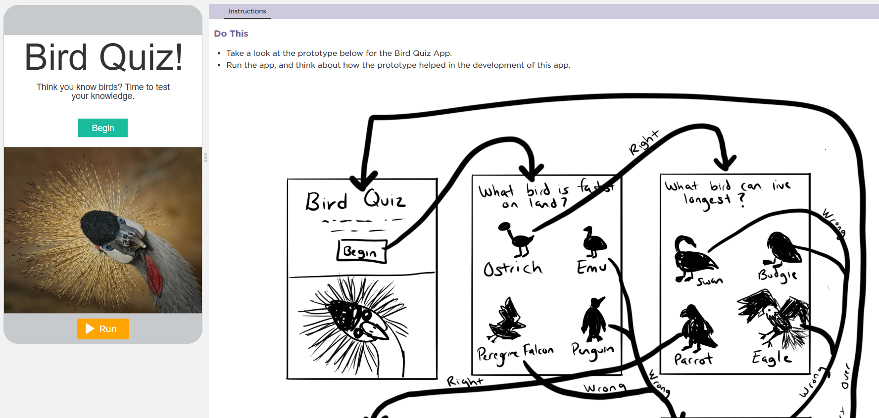

Unit 3 Lesson 4 - Activity
Step 5: Create Your User Interface
Do This: Navigate to Code Studio, Lesson 4, Level 1. Follow the instructions.

