Slide 1
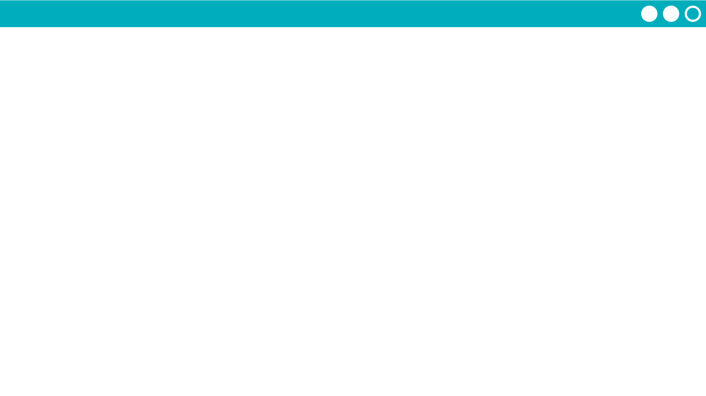
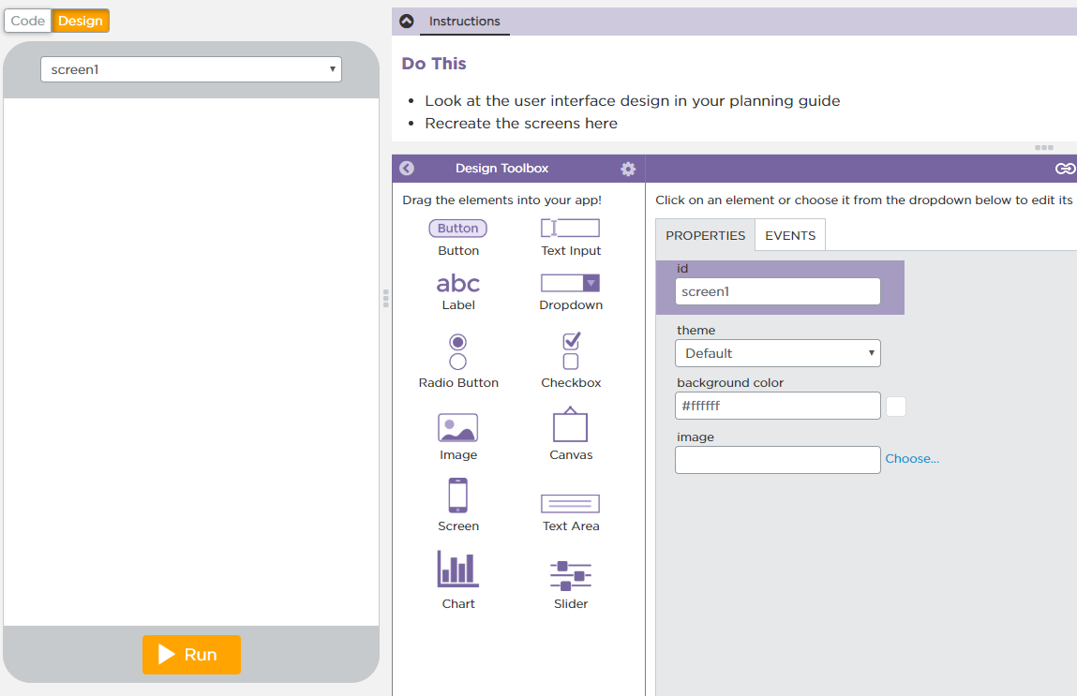

Unit 3 Lesson 4 - Activity
Do This: Navigate to Level 2.
Start building your user interfaces!

