Slide 1

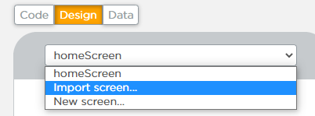
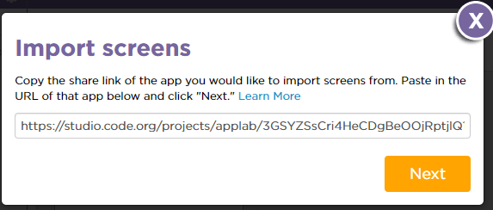
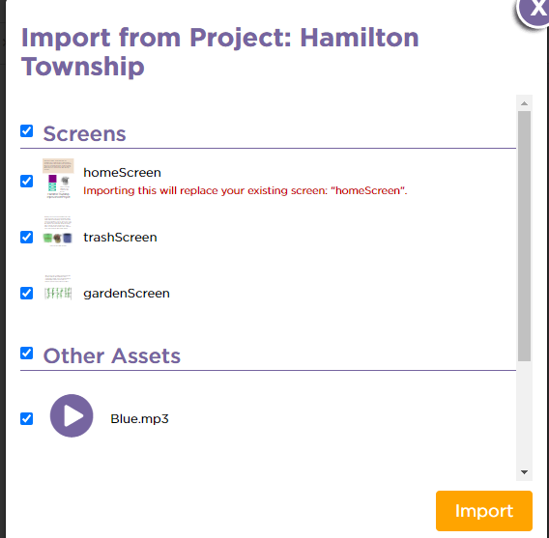
Unit 3 Lesson 4 - Activity
If you divided the screens with a partner, here's how to combine them into one project.
Partner A
Partner B
Choose one partner to host the project (Partner A).
Partner A clicks the screen dropdown, then clicks "Import screen"
Paste in the share link from Partner B.
Partner A select to import all of the screens and assets.
Partner A set the home screen to be the default screen (Hint: Go to design mode and click on the screen)

