Slide 1

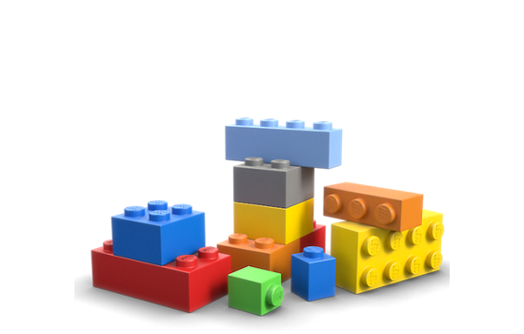
Unit 3 Lesson 5 - Activity
You and your partner should have:
Pen / Pencil
Sheet of paper
A small set of Legos or other blocks
Notes:
Supplies: Red and orange sticky notes
Snack-sized baggies
Dry erase markers
Pens/pencils

