Slide 1

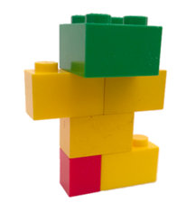


Unit 3 Lesson 5 - Activity
Step 1: Design
Put 5-6 pieces together
All pieces must be connected
Step 2: Record
Take a photo or draw a picture
Color matters
Step 3: Write instructions
Write instructions for building your design
Be as clear and precise as possible
Just words, no drawings, diagrams, or pictures

