Slide 1
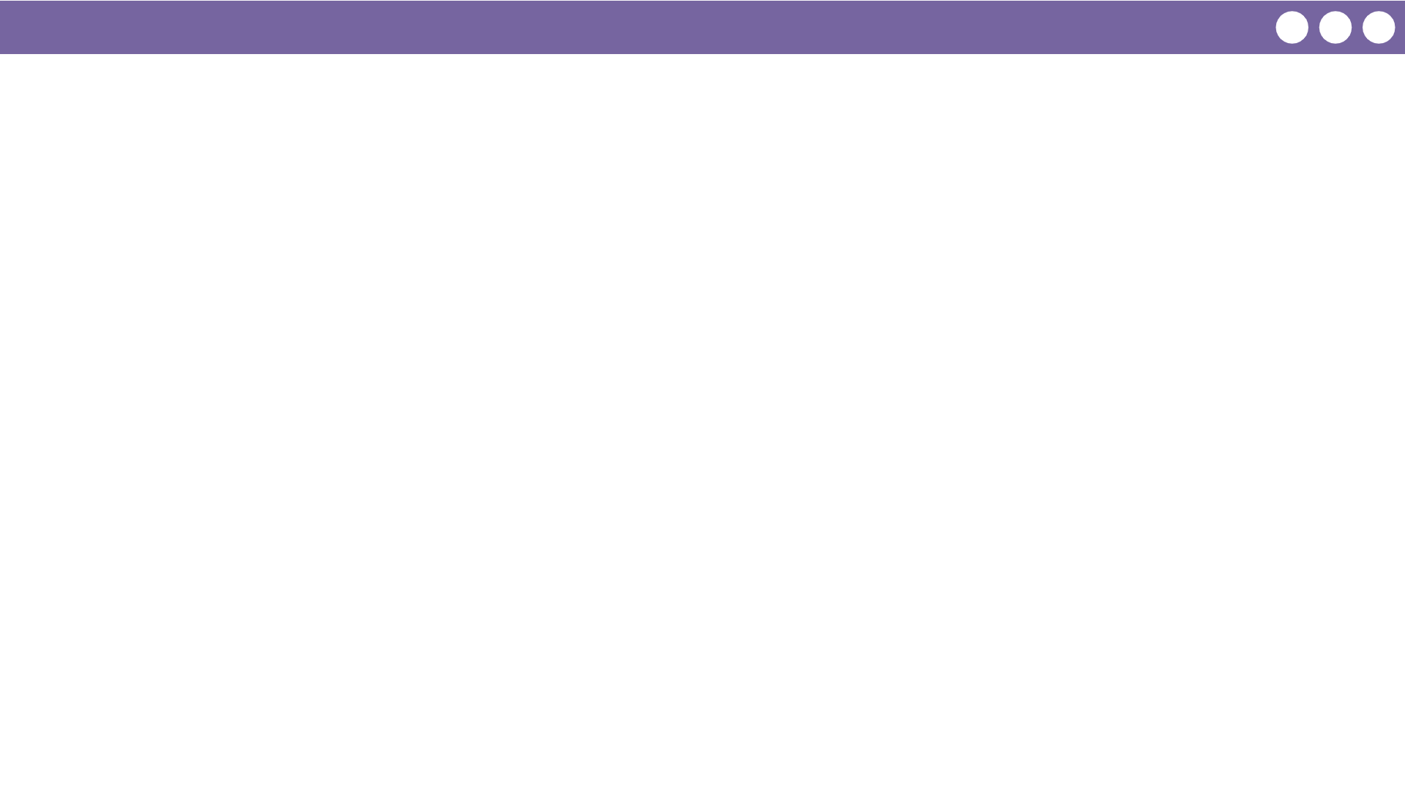
Unit 3 Lesson 5 - Wrap Up
Prompt:
When you or your classmates made mistakes following instructions today what "went wrong"? Try to be as specific as possible.

