Slide 1

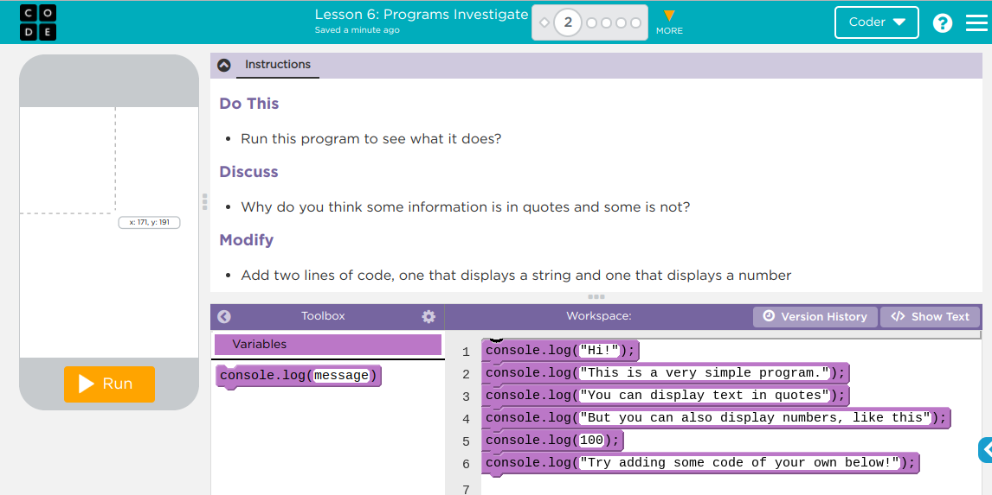
Unit 3 Lesson 6 - Activity
Intro to Programs
You and your partner should:
Work together to complete the “Do This”
Talk through the “Discuss” prompts together
“Modify” the code to follow the directions given
Be prepared to share your discussions with the class

