Slide 1
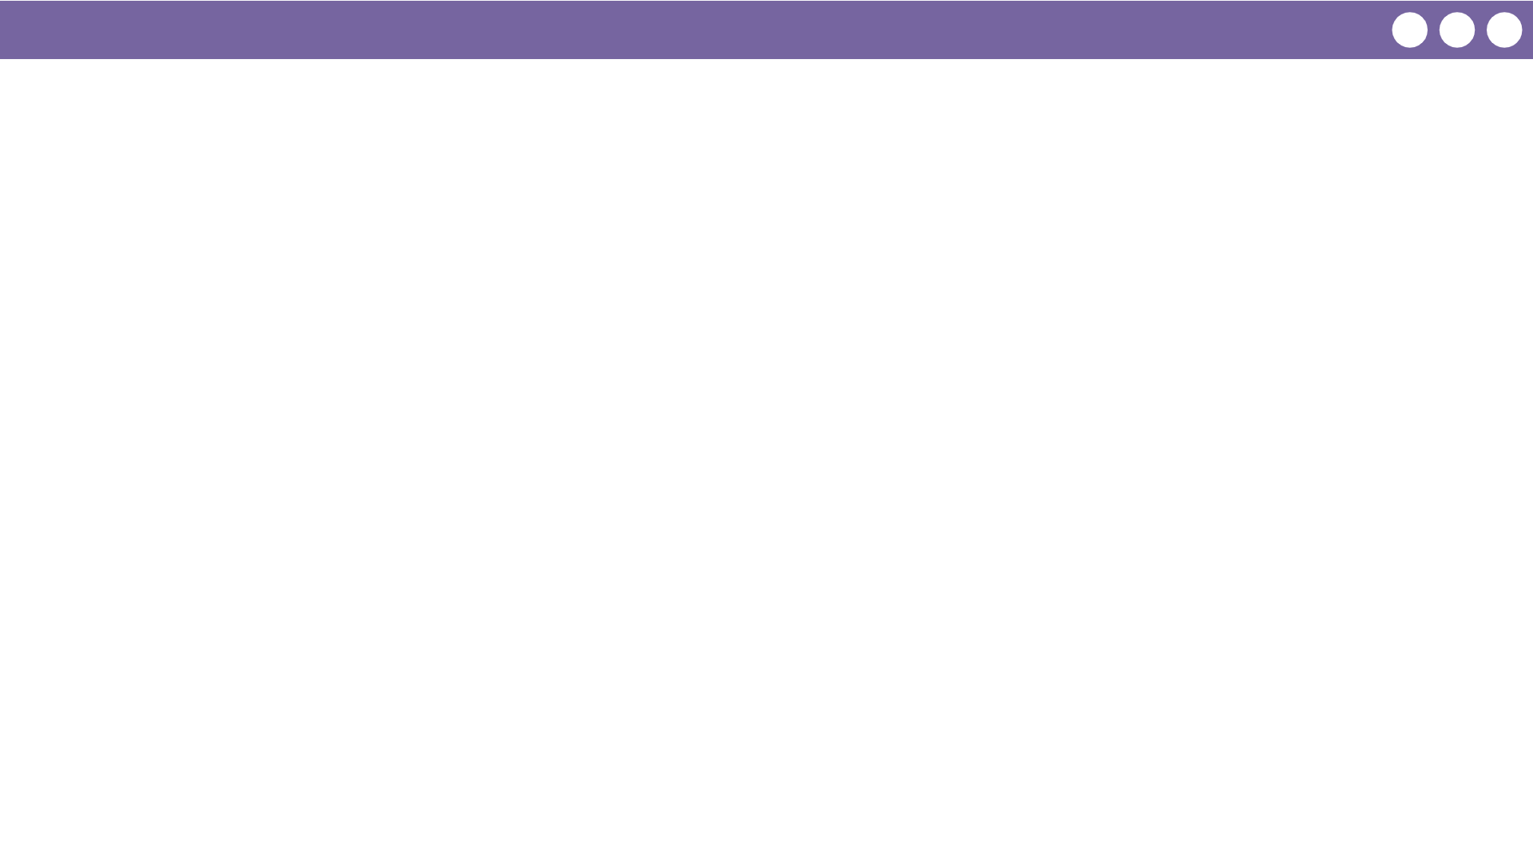
Unit 3 Lesson 6 - Wrap Up
Prompt:
Think about your experiences today and in the previous lesson. How is a programming language different from natural language?

