Slide 1



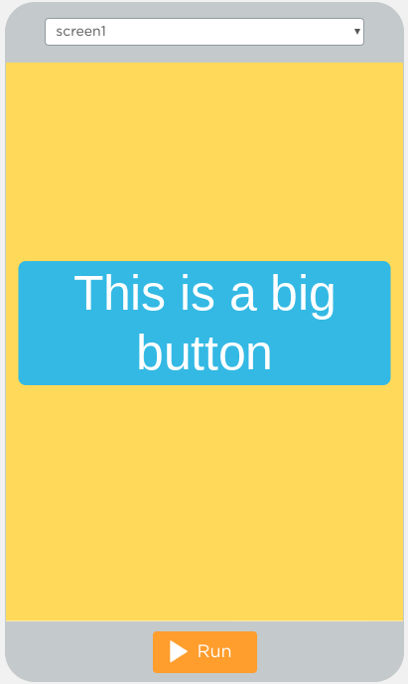
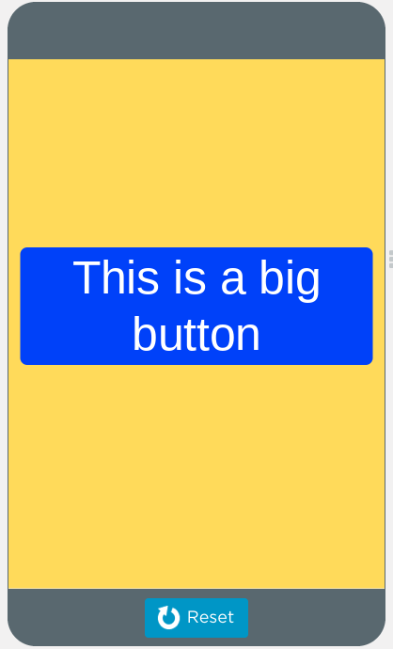

Unit 3 Lesson 6 - Wrap Up
Program Statement: a command or instruction. Sometimes also referred to as a code statement.
Program: a collection of program statements. Programs run (or “execute”) one command at a time.
Command Runs (yellow outline while running)
Before
After

