Slide 1

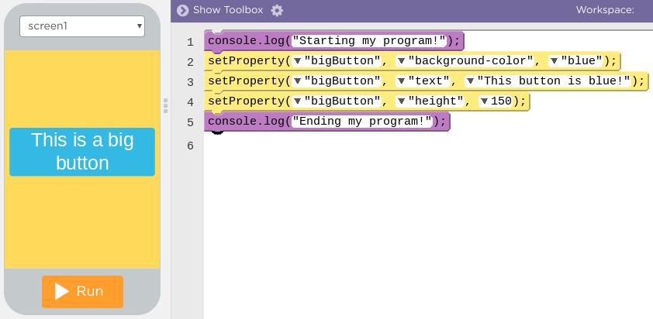
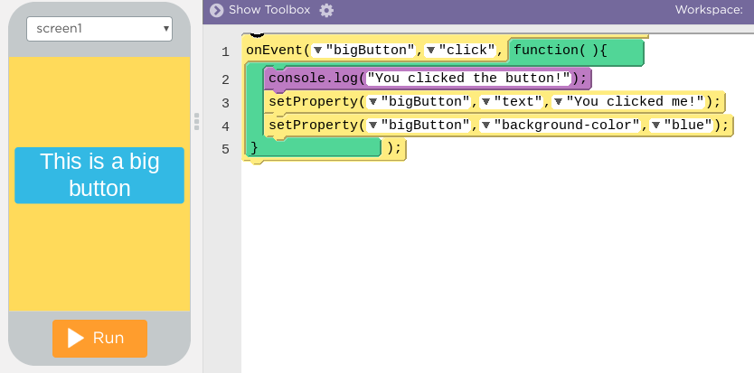
Unit 3 Lesson 6 - Wrap Up
Two different ways for programs to run
Sequential Programming: program statements run in order, from top to bottom.
No user interaction
Code runs the same way every time
Event Driven Programming: some program statements run when triggered by an event, like a mouse click or a key press
Programs run differently each time depending on user interactions

