Slide 1
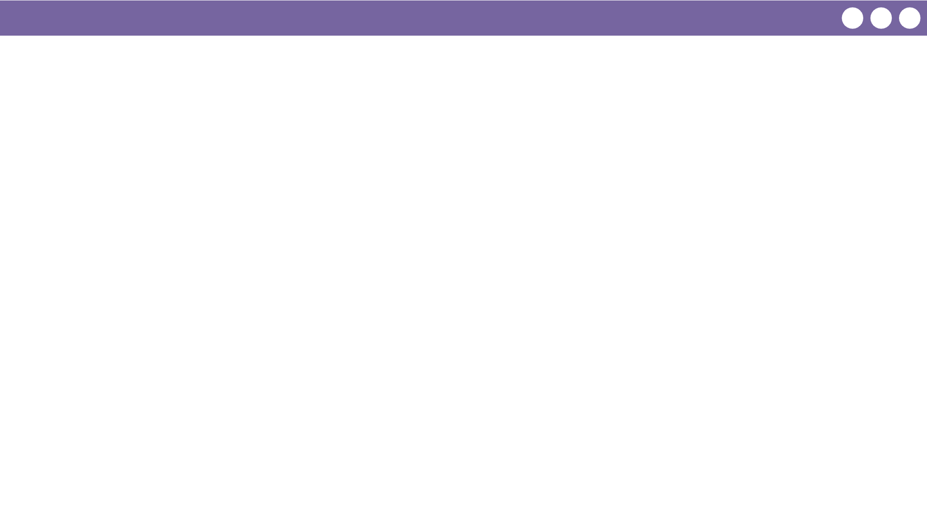
Unit 3 Lesson 7 - Wrap Up
Prompt:
Share any debugging tips you recorded today with your neighbor.
Be ready to share with the class.

