Slide 1

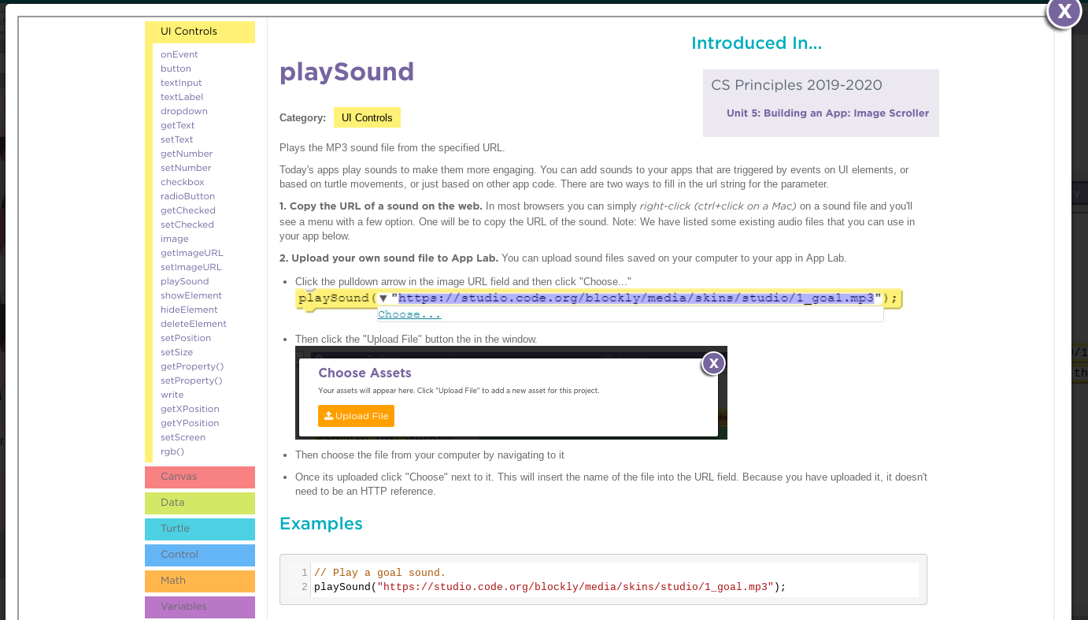
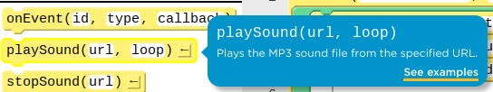
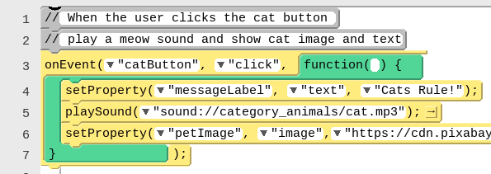
Unit 3 Lesson 7 - Wrap Up
Documentation: a written description of how a command or piece of code works or was developed.
Comment: form of program documentation written into the program to be read by people and which do not affect how a program runs.

