Slide 1

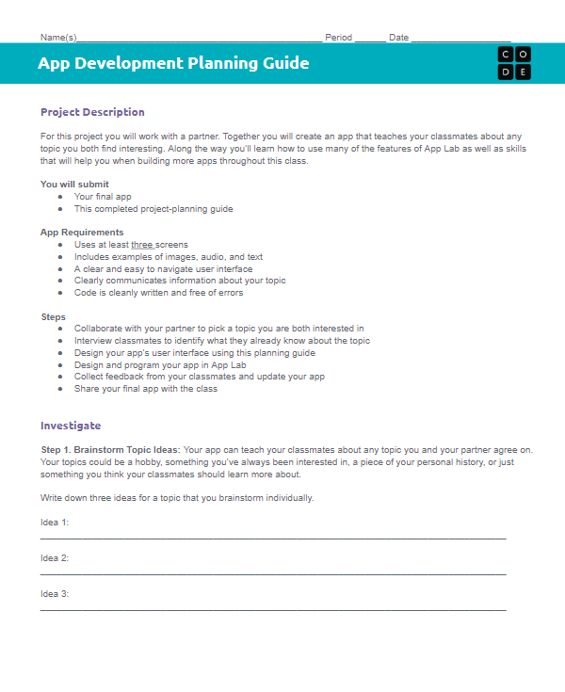
Unit 3 Lesson 8 - Activity
Designing an App Part 3
You should have:
App Development Planning Guide

