Slide 1
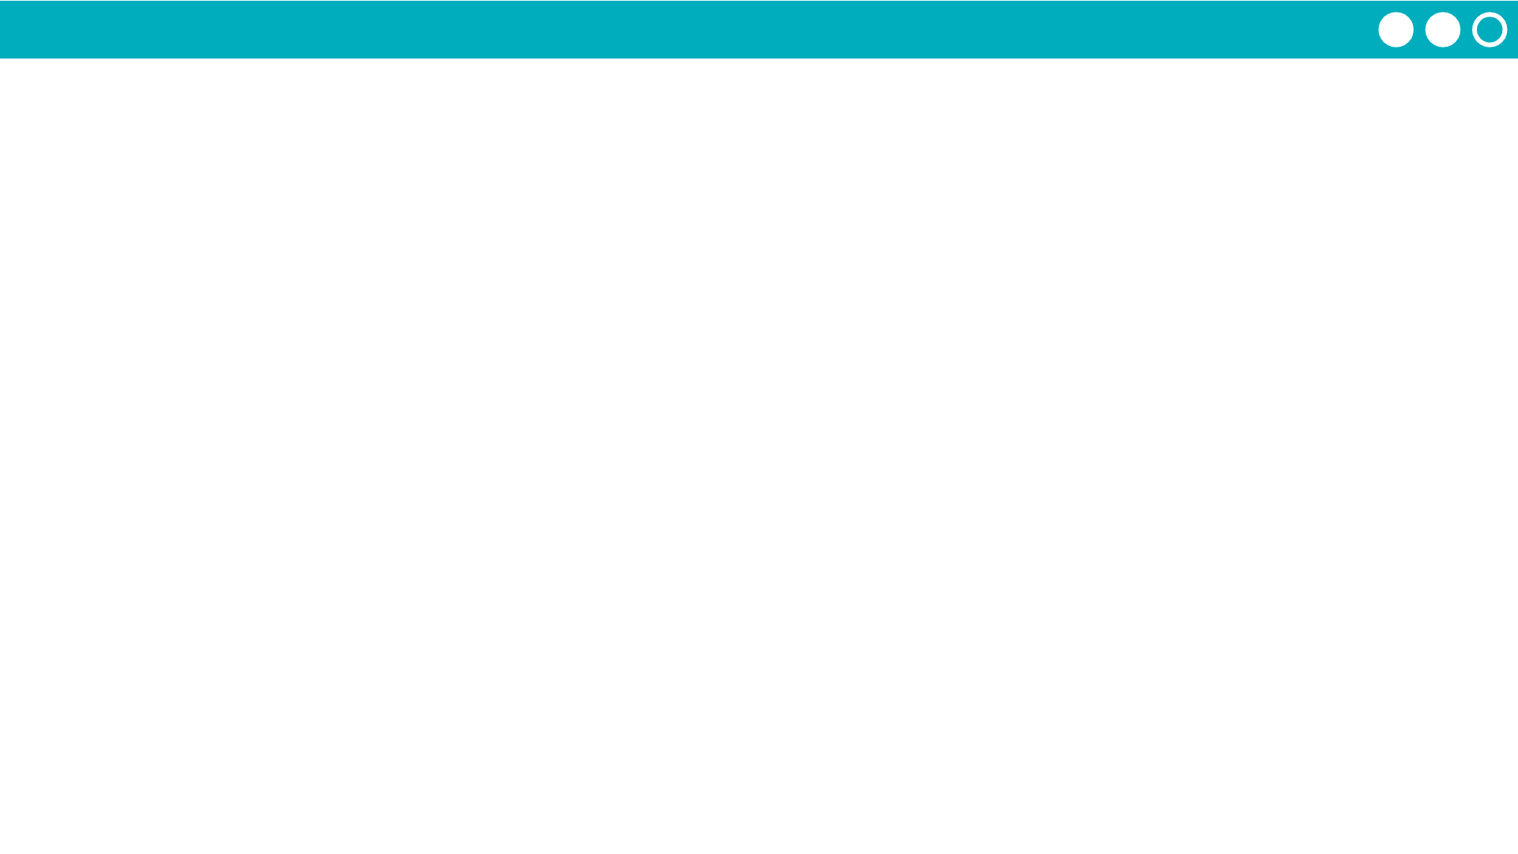
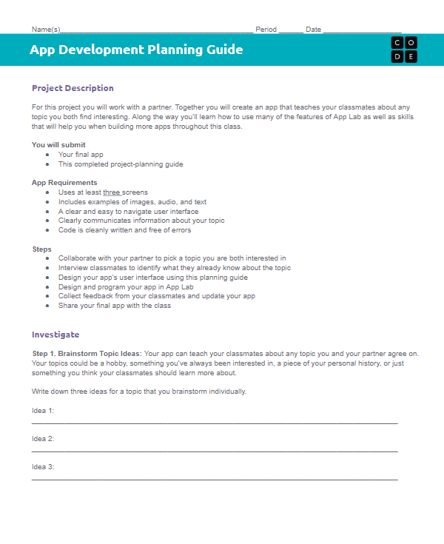
Unit 3 Lesson 8 - Activity
Step 5:
Start Building Your App
Element ID | Action | What happens?
“dogButton” | “click” | A picture of a dog appears The background of the screen changes to green

