Slide 1


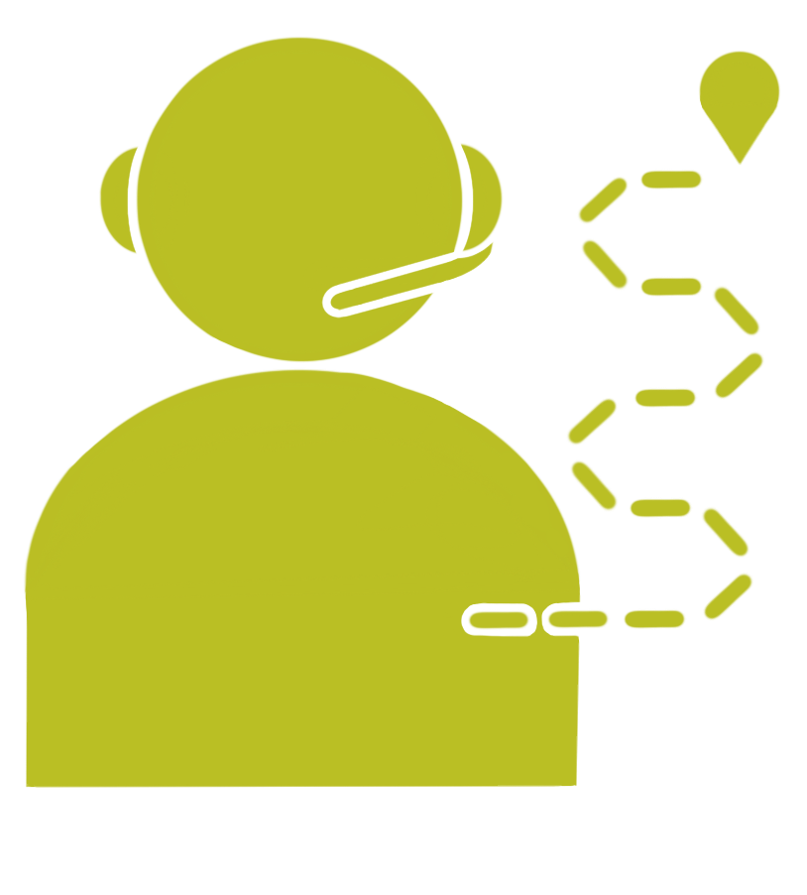
Unit 3 Lesson 8 - Activity
What is Pair Programming?
Driver
Navigator
Manipulates the keyboard and the mouse
Keeps track of the big picture. Guides towards the goal.
You will swap between roles every 3 minutes

